Slide 1
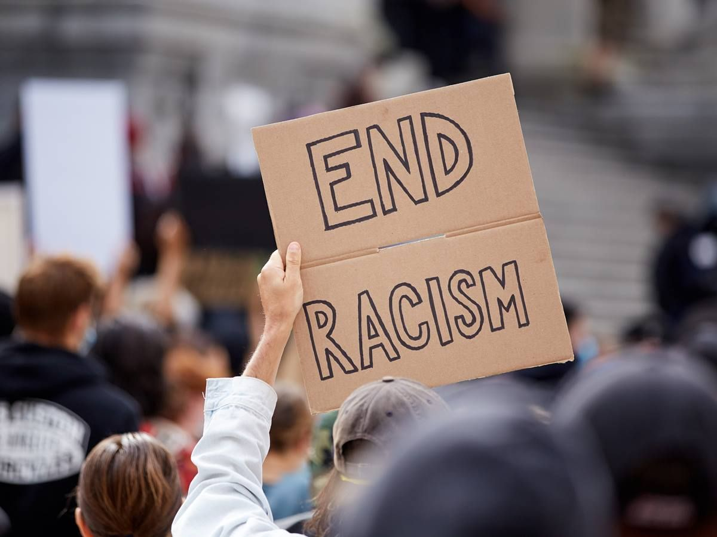
Anti-Racism
Azim Zaheer
11-O

Slide 2
What is Anti-racism
Anti-racism is a process of actively identifying and
opposing racism. The goal of anti-racism is to challenge
racism and actively change the policies, behaviors, and
beliefs that perpetuate racist ideas and actions.
Anti-racism is rooted in action. It is about taking steps
to eliminate racism at the individual, institutional, and
structural levels. It is not a new concept, but the Black
Lives Matter movement has helped increase the focus
on the importance of anti-racism.

Slide 3
Understanding what racism is
Believing that racism is always so direct blinds us from recognizing and examining our own biased beliefs, attitudes, and behaviors.
For example, Merriam-Webster dictionary defined racism as, “a belief that race is the primary determinant of human traits and capacities and that racial differences produce an inherent superiority of a particular race.” In the wake of the George Floyd protests, editors of the dictionary decided to update the definition in response to one reader’s request to more clearly include the role that systemic racism plays.

Slide 4
Why is anti-racism so important?
The problem with systemic racism is that it is all around us. We are born into it. It is deeply embedded in our culture and our communities including our schools, the justice system, the government, and hospitals. It is so pervasive that people often don't even notice how policies, institutions, and systems disproportionately favor some while disadvantaging others.
People often mistakenly believe that simply being “not racist” is enough to eliminate racial discrimination. The problem with this perspective is that White people are often unaware of their own unconscious biases. People often don’t fully understand the institutional and structural issues that uphold White supremacy and contribute to racist behaviors, attitudes, and policies.

Slide 5
The effects of racism
Anti-racism also involves working to understand how race and racism affect people. Research has shown that racism has wide-reaching negative effects on individuals, families, communities, and entire societies.⁵
Racism has an impact in areas you may not have considered including healthcare, education, employment, and housing.
For example:
White households are on average 13 times wealthier than Black households.
Black bachelor’s degree-holders earn significantly less than White bachelor's degree holders. According to data from the Bureau of Labor Statistics, in 2021 the median pay for White workers was about 23% higher than it was for Black workers.

Slide 6


